Slide 1
Environmental Surveying Platform - ESP
Group 12
Devon Wilkerson - CpE
Sergio Gonzalez - CpE
Kris Choudhury - CpE
Benjamin Goerdt - EE

Slide 2
Introduction
Our project is an ‘Level 4’ autonomous vehicle capable of assisting researching with data collection across various types of terrain. The vehicle will utilize self-navigation and be able to avoid different hazards as well as monitor various data points and display it on a UI.
• Level 0 - No automated control
• Level 1 - Some driver assistance; steering or throttle control
• Level 2 - Some driver assistance; steering and throttle control
• Level 3 - Automation; operator controls vehicle when there is a fault
• Level 4 - Automation in a regional area during set times or conditions;
computer controls faults
• Level 5 - Automation anywhere and during all times; computer controls
faults

Slide 3
Motivation
The motivation behind this project was to explore current technologies and to build and design a prototype for an autonomous vehicle that can survey and measure information from many different environments, as well as promote safety standards to current vehicles.
Exploration and safety are key factors that motivated our design, as we hope for this vehicle to one day be used on an extraterrestrial environment and discover and gather a wide variety of information.

Slide 4
Goals and Objectives
To design a vehicle capable of semi-autonomous driving and navigation
To have a user-friendly GUI for sensor monitoring and map control.
To have an abundance of sensors on it to gather data about the surrounding environment
These sensors include: temperature sensors, humidity sensors, oxygen sensors, carbon dioxide sensors, ultraviolet sensors, particulate matter sensors, volatile organic compound sensors, ozone sensors, light sensors, ultrasonic (proximity) sensors, and multiple cameras.
To have this data aid in the study of the condition of the surrounding environment, and also give us insight to the habitability of the areas the vehicle traversed.

Slide 5
Specifications and Requirements
Run Time | Must run a minimum of 1 hour.
Charge Time | Must charge in a maximum of 6 hours.
Manual Driving Speed | Must be able to maintain a manual driving speed of 5km/h
Autonomous Driving Speed | Must be able to maintain an autonomous driving speed of 5km/h
GPS Display | Must display correct GPS coordinates within 2m.
Wifi/GSM Connectivity | Must be Wifi/GSM connected.
Planning/Routing Capabilities | Must be able to plan and execute routing within 10s.
Quick GUI Feedback | Screen must give feedback within 100ms.
Occupant Weight Limit | 1 seats for occupant with a 50lb limit
Maximum Weight Limit | Must be able to hold a maximum of 60 pounds
Object Detection | Must detect external objects within 1s at 4m
Notes:
Talk about original specs and why we changed them to fit the smaller vehicle. (Pedestrian safety, passenger safety, etc)

Slide 6
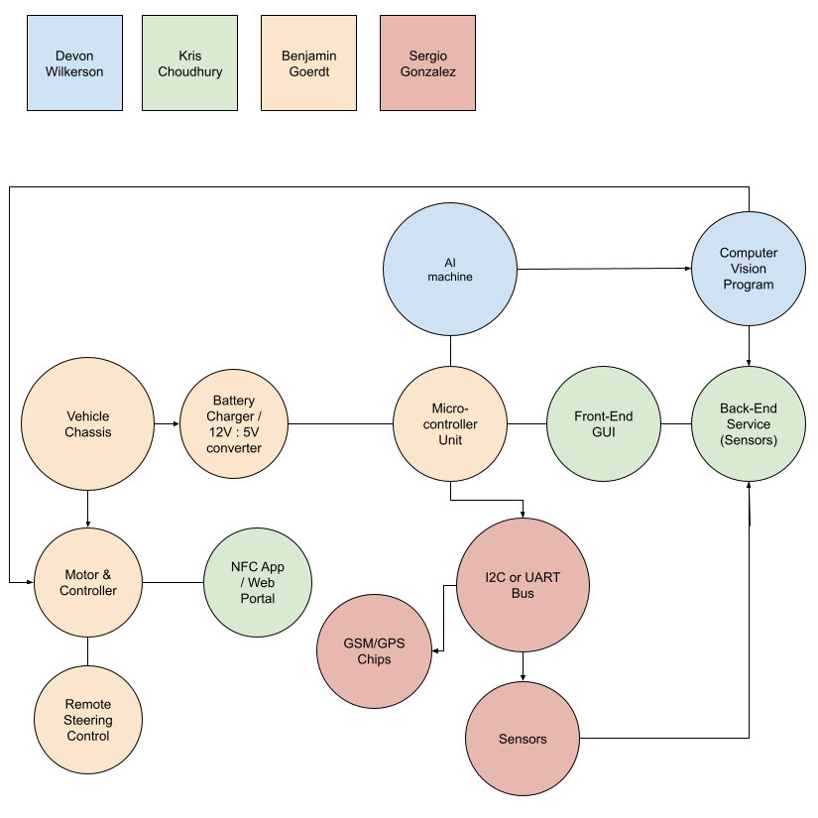
Design
Notes:
Talk about why we designed our vehicle this way

Slide 7
Bill of materials
Manufacturer | Part No. | Description | Quantity | Price | Quantity on Hand
NVIDIA | 945-13541-0000-000 | Jetson Nano System on Module - SOM Development Kit 4GB RAM Linux | 1 | 99.00 | 5
CanaKit | PI4-4GB-STR32F-C4-BLK | Raspberry Pi 4 - Starter Kit 4 GB Ram + 32 GB of Storage | 1 | 99.95 | 1000+
XYGStudy | SIM7600G-H 4G HAT | GSM Communication Module 4G 3G 2G for Raspberry Pi | 1 | 86.99 | 10
SixFab | S121 | Raspberry Pi 4G/LTE Cellular Kit | 1 | 109.99 | 236
Arduino | A000066 | Arduino Uno Rev 3 based on ATMEGA328p | 1 | 23.00 | 1000+
Seeed Studio | 109020022 | Grove Air530 GPS Module | 1 | 9.88 | 126
Raspberry Pi | LCD-13733 | Raspberry Pi Foundation 7" Touchscreen LCD Display | 1 | 60.00 | 1000+
Sixfab | S121 | Raspberry Pi 4G/LTE Modem Kit | 1 | 109.00 | 203
Xinpuguang | 100W | Solar Panel & Charge Controller | 1 | 80 | 268
Traxxas | RC775 | High Power Drive Motor | 2 | 40.95 | 199+
Best Choice Products | 12V-BL | Power Wheels Vehicle | 1 | 189.99 | 20+

Slide 8
Bill of materials - Continued
Manufacturer | Part No. | Description | Quantity | Price | Quantity on Hand
Adafruit | VEML7700 | Light Sensor | 2 | 4.95 | 761
Adafruit | VEML6070 | UV light sensor | 1 | 5.95 | 226
Adafruit | AM2320 | Temperature and Humidity Sensor | 1 | 3.95 | 304
DFRobot | SEN0322 | Oxygen Sensor | 1 | 53.90 | 68
Amphenol Advanced Sensor | T6703-5k | Carbon Dioxide Sensor | 1 | 37.99 | 95
Adafruit | PMSA003I | Particulate Matter Sensor | 1 | 37.99 | 6
Adafruit | SGP40 | Volatile Organic Compounds Sensor | 1 | 14.95 | N/A
Adafruit | HC-SR04 | Proximity Sensor | 4 | 7.94 | 11
Pololu | D24V50F5 | Voltage Regulator | 1 | 19.99 | 100+
Phoenix | 1729128 | Screw Terminal | 2 | 1.14 | 15,750
Songhe | ‎C9 | 3A High Power Motor Driver | 1 | 13.99 | 30+
Schwinn | SW75248A-5 | Bicycle Chain | 3 | 6.99 | 30+
Adafruit | B01HNA1A6M | L3GD20H Triple-Axis Gyro | 1 | 13.43 | 30+
Powkey | B0713XJBG2 | 200Watt with AC Outlet 42000mAh Power Supply | 1 | 149.99 | 30+
Adafruit | B0149KK6SW | Accelerometer+Magnetometer Board - LSM303 | 1 | 14.95 | 30+

Slide 9
Budget
Our goal was to contribute $500 each, for a total budget of $2,000.
Sensors | 405
Computing Devices | 300
PCB & misc components | 75
Chassis | 250
Battery/Solar | 150
Drive Upgrades | 190
Misc Prototyping | 300
Total | $1670

Slide 10
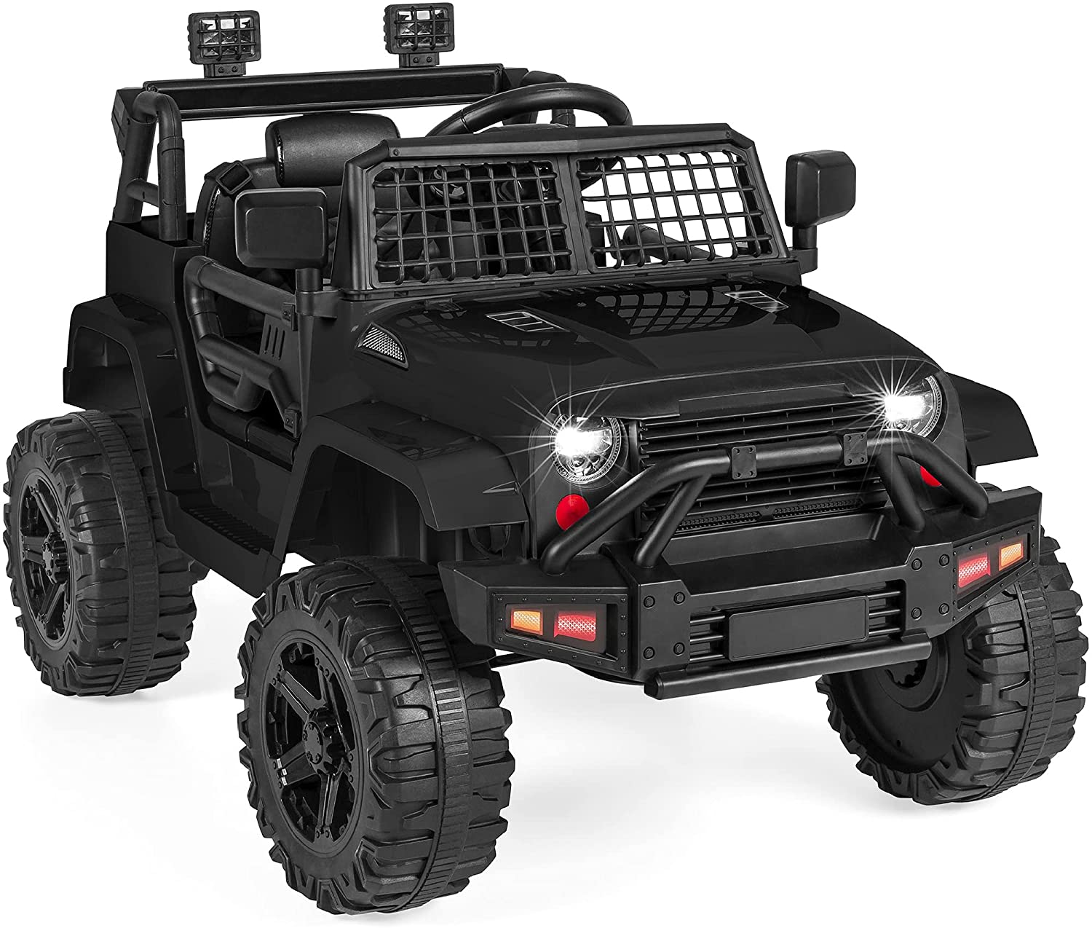
Vehicle (Power Wheels)
12V Battery operated power wheels
Includes a remote control
Electronic steering capability
Replaceable battery
Room for motor upgrade

Slide 11
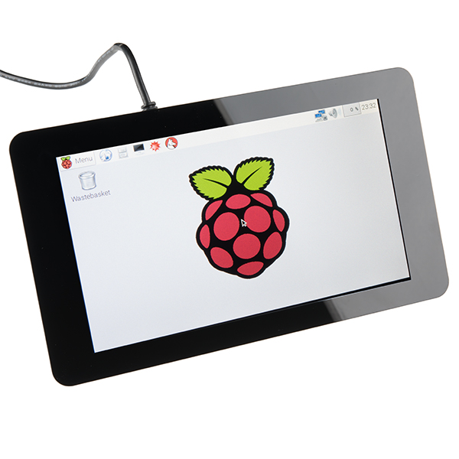
Interface (Monitor)
The interface we are using is a Raspberry Pi 7” LCD touchscreen display. The screen will be displaying our node-red UI and allow for the user to interact with it to send GPS coordinates for the vehicle to navigate to, as well as display environmental information.
Notes:
Discuss the reason for a touchscreen interface, why we chose this one specifically, etc.

Slide 12
UI
The UI displays the sensor information such as temperature, oxygen, and many more. The UI was created using Node-Red which is hosted on a Raspberry Pi that receives sensor information via I2C communication and displays the corresponding info to visual components.
The UI also has GPS functionality with a map component lets you add waypoints to travel to. Waypoints that are added are then sent out via serial port to our Jetson Nano to use in ROS.
Notes:
Discuss how node-red will be used for the UI, then explain the two screenshots

Slide 13
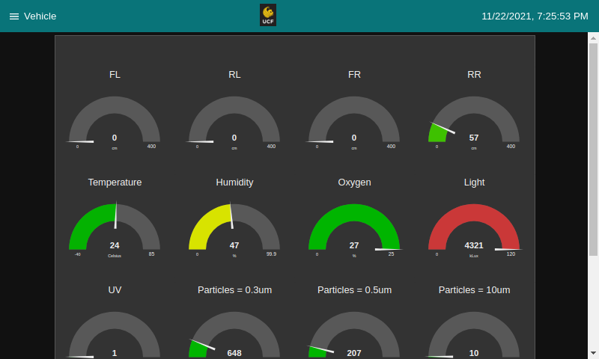

Slide 14
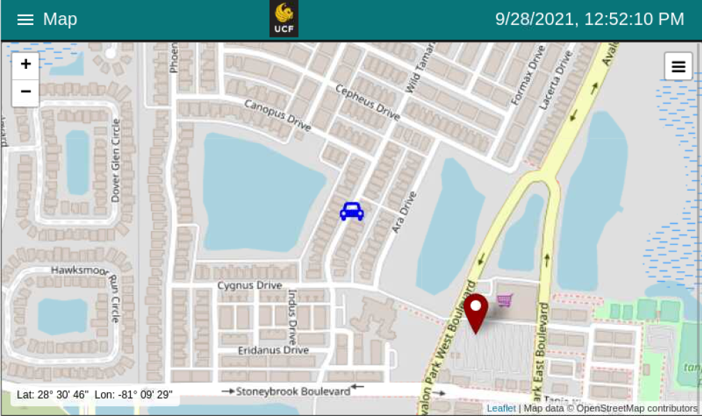
Notes:
How buggy navigation will work, GPS coordinates are received at around 2 ms to 6 ms.

Slide 15
UI Locking
As a way to secure our UI, we added a lockscreen mechanism utilizes the DFRobot NFC Sensor.
By default, our UI is locked upon turning on the vehicle and requires the user to scan a designated RFID card onto the NFC sensor to unlock.
Once unlocked, the user has access to sensor information and the mapping components.
In order to lock it again, the user can scan the card again and the UI will lock.

Slide 16
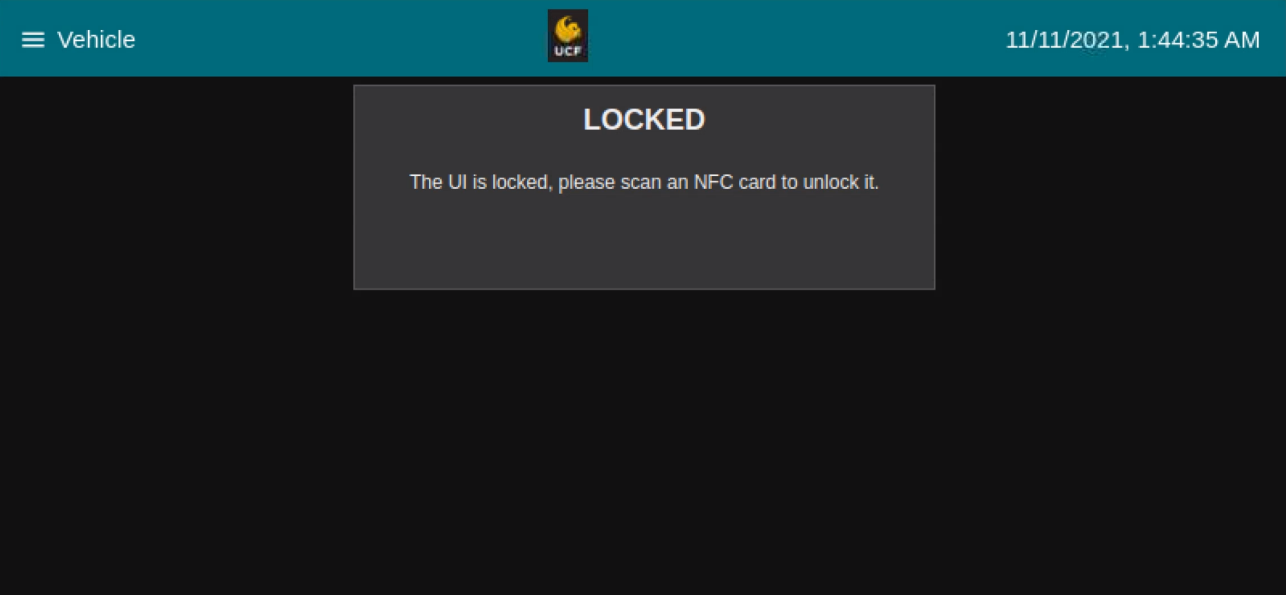

Slide 17
The vehicle is controlled via ROS and an NVIDIA Jetson Nano
There are two modes of operation: GPS Waypoint Navigation, teleoperation.
GPS Navigation will be controlled by GPS data, ROS’s Navigation Stack, and the Robot_Localization package.
Teleoperation will be controlled remotely with ROS.

Slide 18
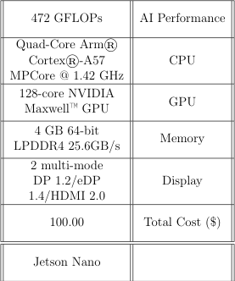
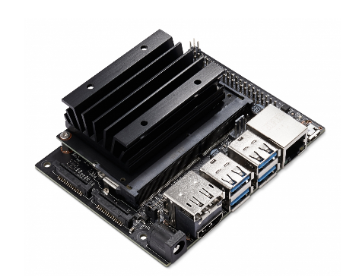
NVIDIA Jetson Nano
This is a low cost, powerful machine that will handle all of the vehicle’s control and object detection systems.

Slide 19
ROS & ROS nodes
ROS is a set of software libraries and tools that help you build robot applications. (ROS.org)
The basic nodes that will be used are:
Motor - Driving the vehicle
Encoders - Localization
Camera - Object Detection
Depth Cloud - Object Detection
Range Sensor - Object Detection
GPS - Odometry and localization
Compass - Odometry and localization
IMU - Localization

Slide 20
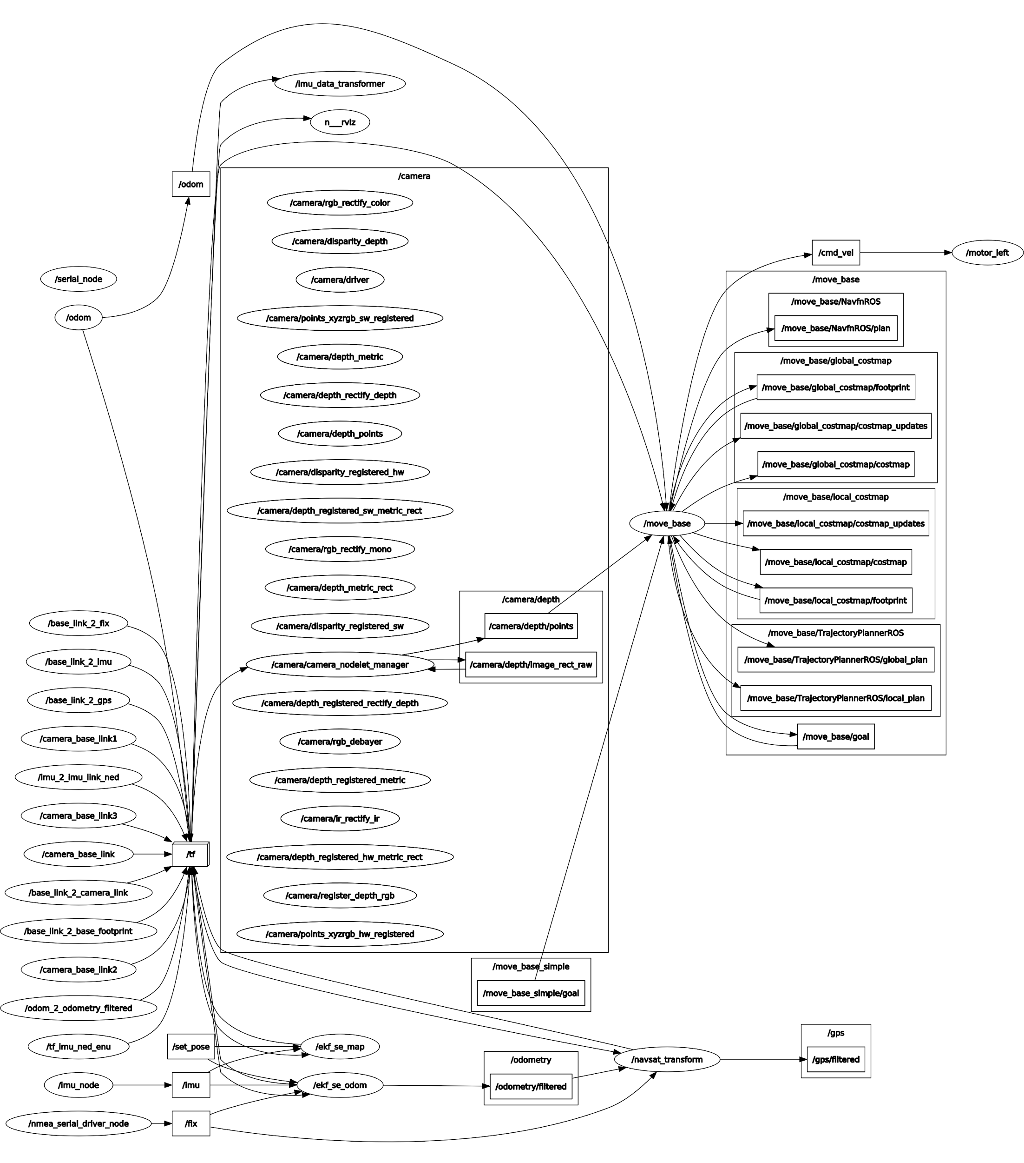
ROS Node Graph - Overview

Slide 21
ROS Node Graph - Motors, Encoder GPS, Compass, IMU

Slide 22
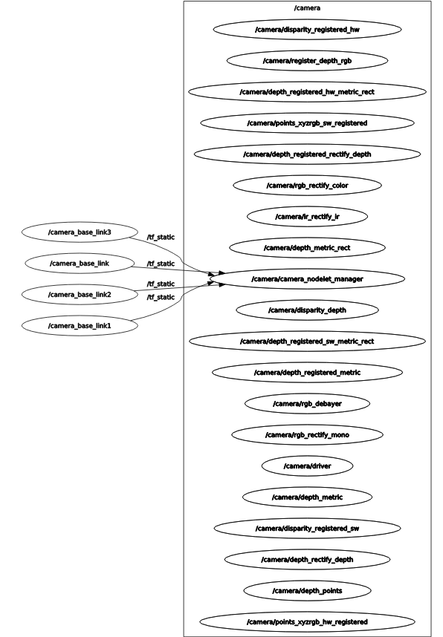
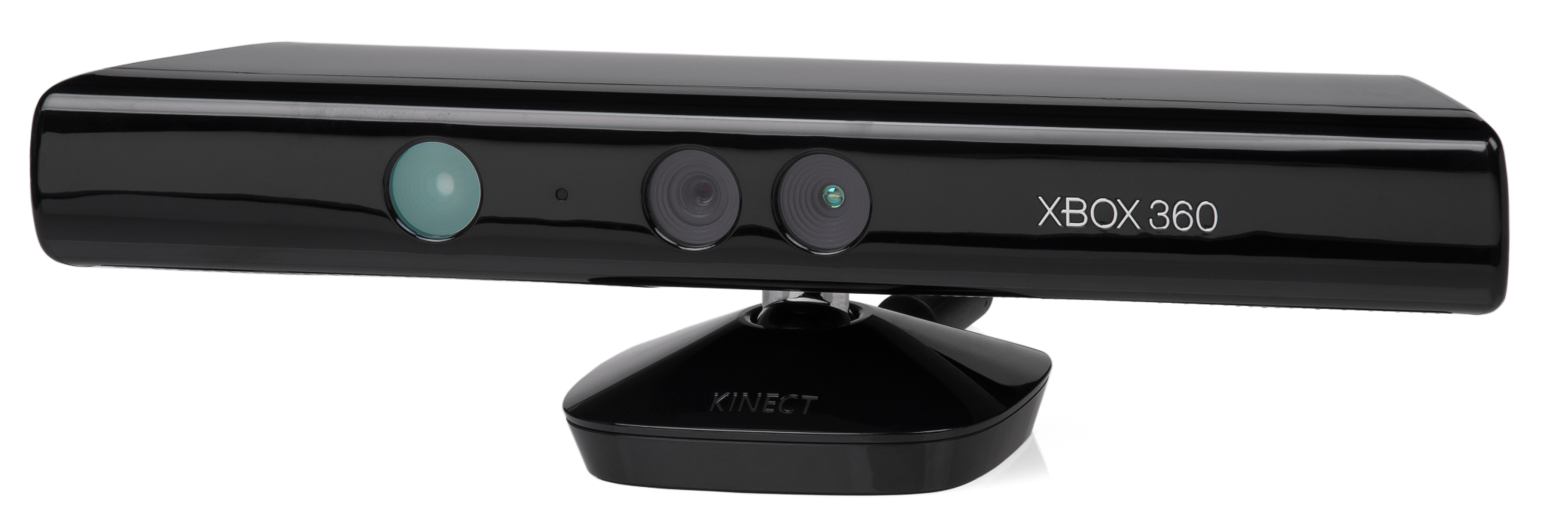
ROS Node Graph - Camera & Depth Cloud
A kinect will serve as the camera and depth sensor.
This will give the mobile robot “sight” to aid in localization and object detection

Slide 23
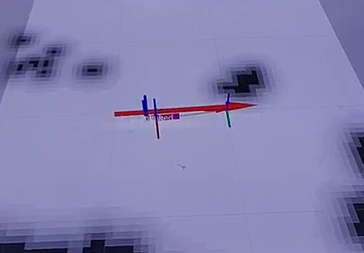
Vision
The Kinect and Range sensors are used for object detection.
The data is fed into a costmap to update obstacles in the world.
The costmap builds an occupancy grid based on the data, and keeps track of occupied, free, and unknown space.

Slide 24
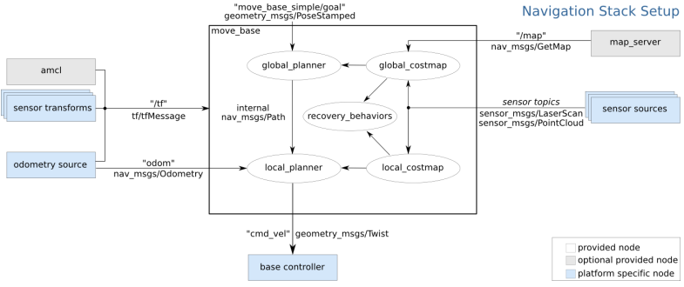
Navigation Stack

Slide 25
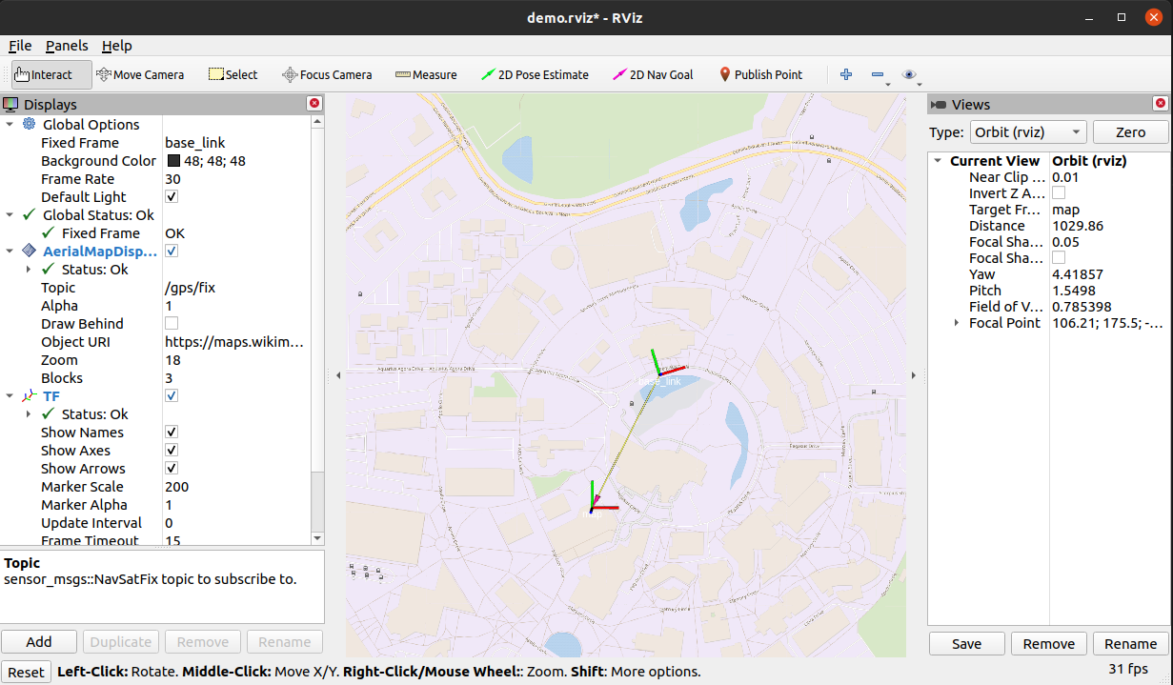
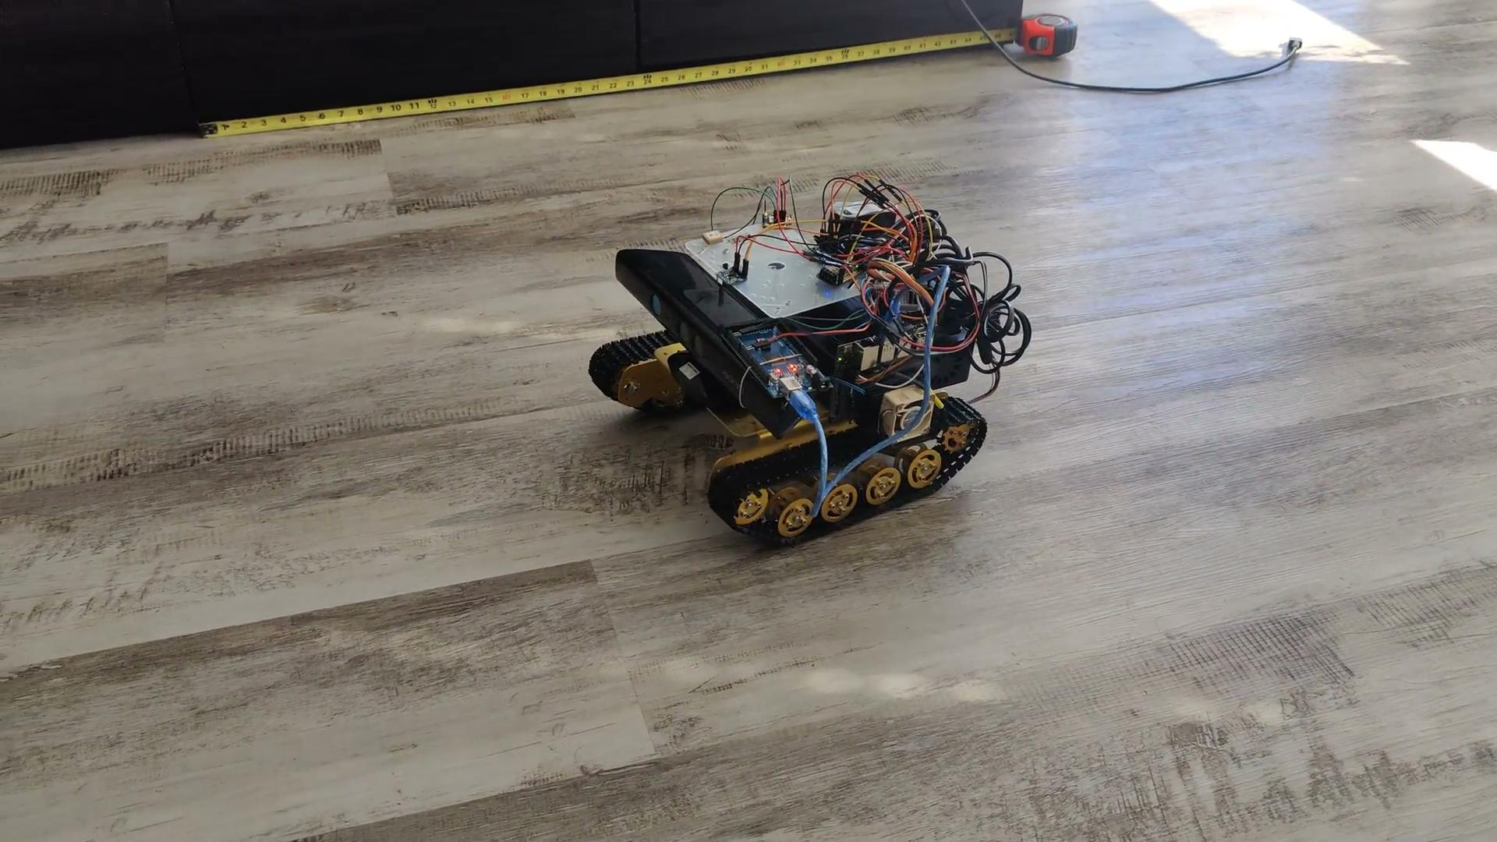
GPS Waypoint Navigation

Slide 26
Teleoperation
Why have this option?
Unexpected failure
Difficult to navigate terrain
Power saving
Safety

Slide 27
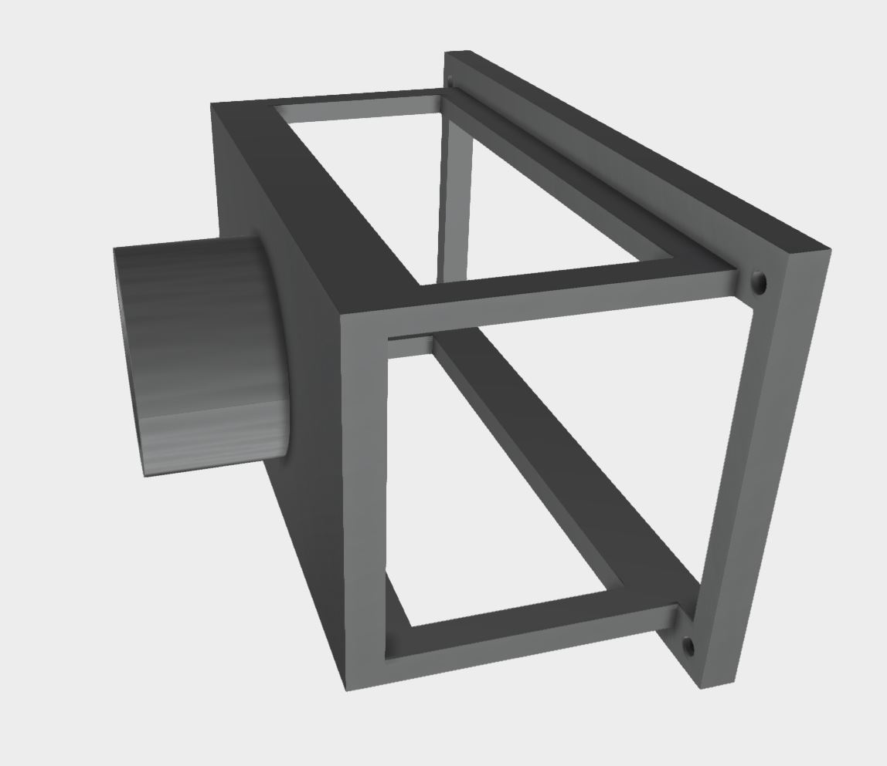
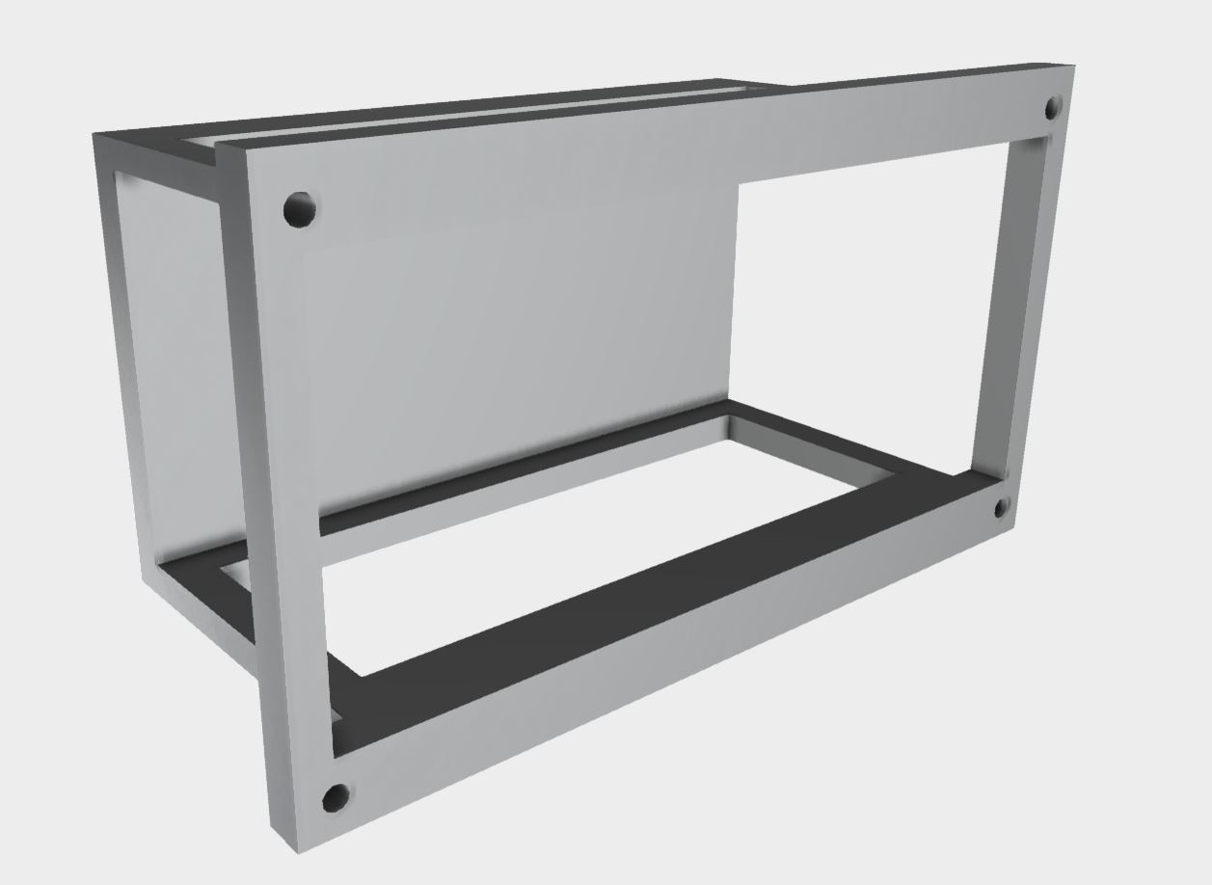
Touchscreen mount
Steering wheel was removed
Press fit
Allows adequate airflow to the raspberry pi

Slide 28
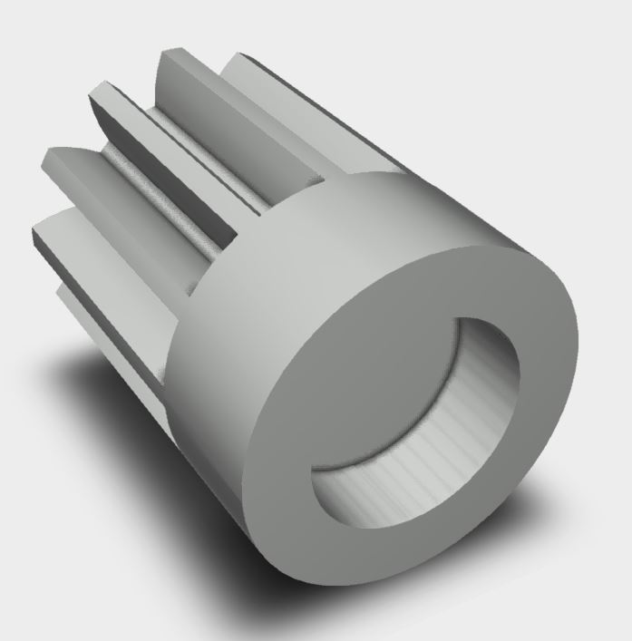
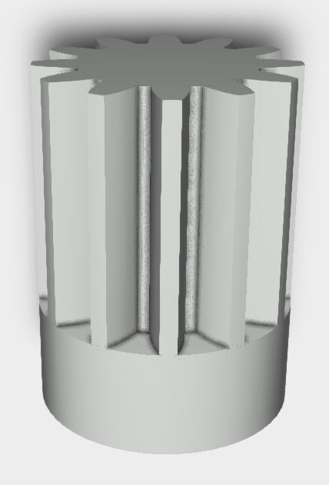
Gear Extension
Epoxy attachment to drive motor in gearbox
Changed height and diameter of the gear

Slide 29
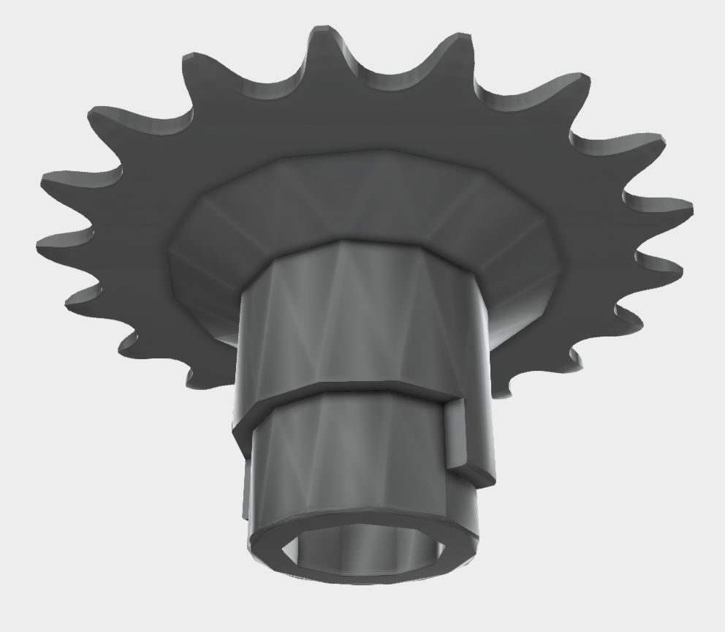
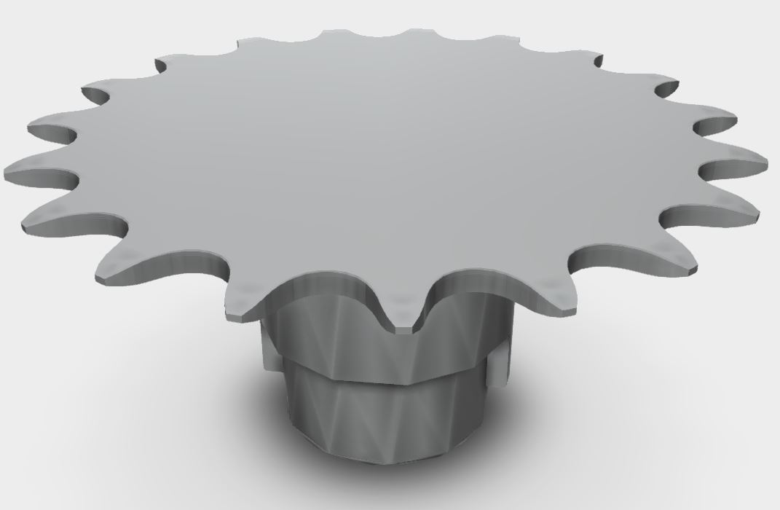
Hub Drive Sprocket
Press fit attachment into wheel hub
Peg lock for anti-rotation
Allowed the modification from a linear actuator to tank-drive steering

Slide 30
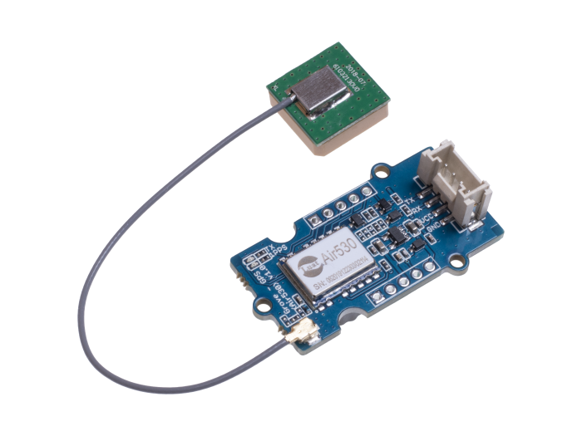
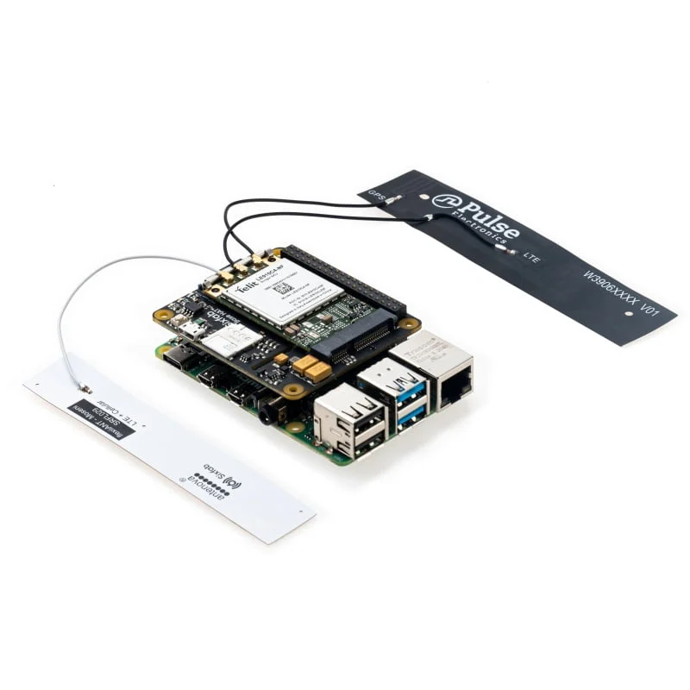
GPS/GSM
The vehicle uses a GPS module: the Grove Air-530 to map the current location of the vehicle on the UI.
The design also uses SixFab 4G/LTE Cellular Modem Kit, which allows the our UI to connect to cellular networks as a backup if the vehicle isn’t in a location that has an established Wi-Fi network.

Slide 31
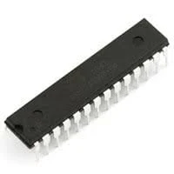
ATMega328P-U Microcontroller
AVR | Core Processor
8-Bit | Core Size
20 MHz | Speed
32KB | Program Memory Size
Flash | Program Memory Type
1K * 8 | EEPROM Size
2K * 8 | RAM Size
1.8V 5.5V | Voltage - Supply (Vcc/Vdd)
28 | Number of IO pins
$2.63 | Cost

Slide 32
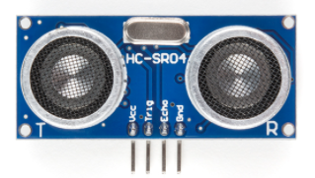
HC-SR04 Distance Sensor
Has a range between 0 and 400 centimeters
Our vehicle with have four of these, one of each of the cardinal points of the car.
Analog
Using these sensors, the driver will be notified via the touchscreen display that the vehicle is too close to an object
3.1V - 5V | Working Voltage
Analog | Communication
400cm | Max Range
0cm | Min Range
$7.95 | Cost

Slide 33
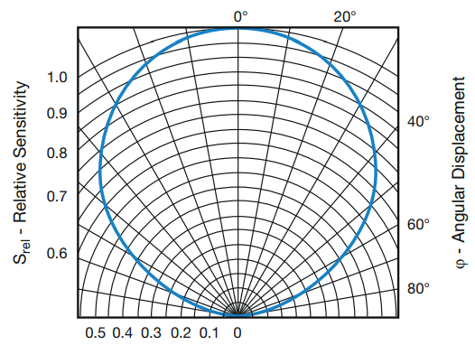
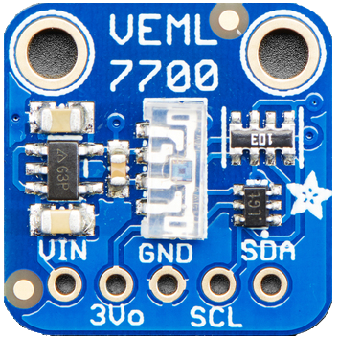
Adafruit VEML7700 Light Sensor
2.5V - 3.6V | Working Voltage
I2C | Communication
120klux | Max Range
0lux | Min Range
$4.95 | Cost
Calculates the lux of the surrounding area
Will be used to turn on vehicle headlights
Has I2C communication

Slide 34
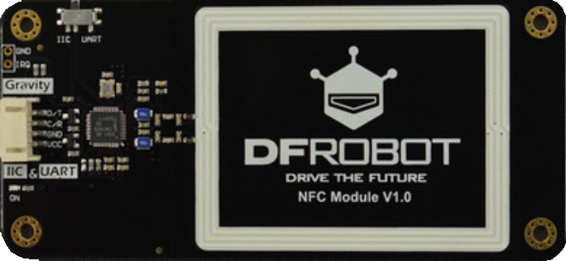
DFRobot NFC Sensor
Can communicate with either i2c or UART
Different protocol support
Reader/Writer
Card Emulation
Peer-to-Peer
Will unlock the touchscreen after communication with NFC tag.
If scanned again, screen will lock

Slide 35
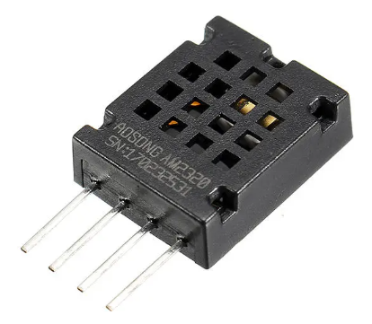
Adafruit AM2320 Temperature and Humidity Sensor
Measures temperature in between -40 to +80 degrees Celsius
Measures Humidity between 0 to 99.9 %RH (relative Humidity)
I2C Communication
3.1V - 5.5V | Working Voltage
I2C | Communication
+85० Celsius | Max Temp Range
-40० Celsius | Min Temp Range
99.9% | Max Humidity Range
0% | Min Humidity Range
$3.95 | Cost

Slide 36
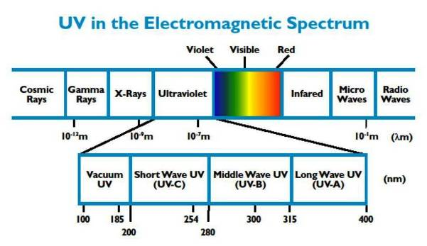
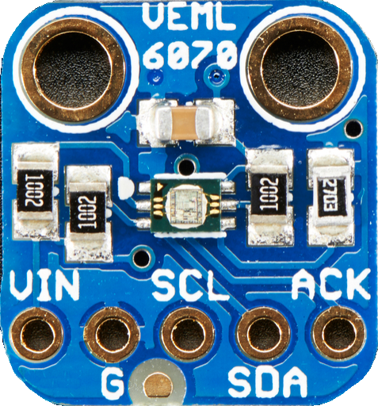
VEML 6070 UV Sensor
The is capable of detecting light in the UV spectrum. More specifically the UV-A spectrum
Does not produce a UV index value so calibration will be required.
Uses I2C for communication
2.7 V to 5.5 V | Working Voltage
I2C | Communication
410 nm | Max Range
320 nm | Min Range
$4.95 | Cost

Slide 37
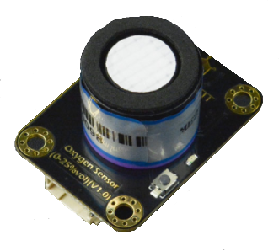
DFRobot SEN0322 Oxygen Sensor
Can measure the amount of oxygen in the air up to 30%
Unsafe Oxygen percentage is 19.5% and below
I2C communication
3.3V - 5.5V | Working Voltage
I2C | Communication
30% | Max Range
0% | Min Range
$53.90 | Cost
Notes:
Can measure the amount of oxygen in the air up to 25%, for reference, the amount of oxygen in the area is around 25%
Minimum safe level of oxygen for humans is 19.5%
------Explain What VOC’s are:
They are harmful gases that can emit from things such as paints and lacquers, paint strippers, cleaning supplies, pesticides, building materials and furnishings, office equipment such as copiers and printers, correction fluids and carbonless copy paper, graphics and craft materials including glues and adhesives, permanent markers, and photographic solutions.

Slide 38
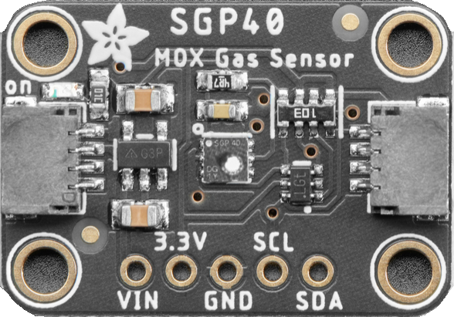
Adafruit SGP40 VOC Sensor:
Outputs a Volatile Organic Compounds index value
VOC’s can come from everyday things such as paint, cleaning supplies, office supplies, and more...
I2C communication
1.7V - 3.6V | Working Voltage
I2C | Communication
500 VOC index points | Max Range
0 VOC index points | Min Range
$4.95 | Cost
Notes:
Can measure the amount of oxygen in the air up to 25%, for reference, the amount of oxygen in the area is around 25%
Minimum safe level of oxygen for humans is 19.5%
------Explain What VOC’s are:
They are harmful gases that can emit from things such as paints and lacquers, paint strippers, cleaning supplies, pesticides, building materials and furnishings, office equipment such as copiers and printers, correction fluids and carbonless copy paper, graphics and craft materials including glues and adhesives, permanent markers, and photographic solutions.

Slide 39
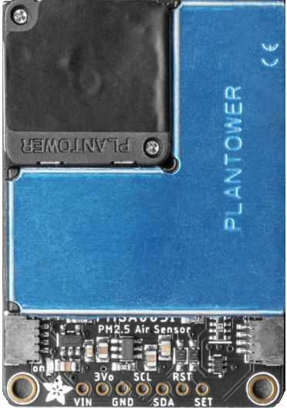
Adafruit PMSA003I Particulate Matter Sensor:
Uses laser scattering to detect particles in small air samples
Determines size of particle and places data in a bin representing size.
Outputs the number of particles suspended in the air sample
I2C communication
4.5V - 5.5V | Working Voltage
I2C | Communication
10um | Max Range
0.3um | Min Range
$44.95 | Cost

Slide 40
Motor Power System
A 12V 4.5Ah OEM battery is installed
Can be charged in vehicle, or swapped for minimal downtime

Slide 41
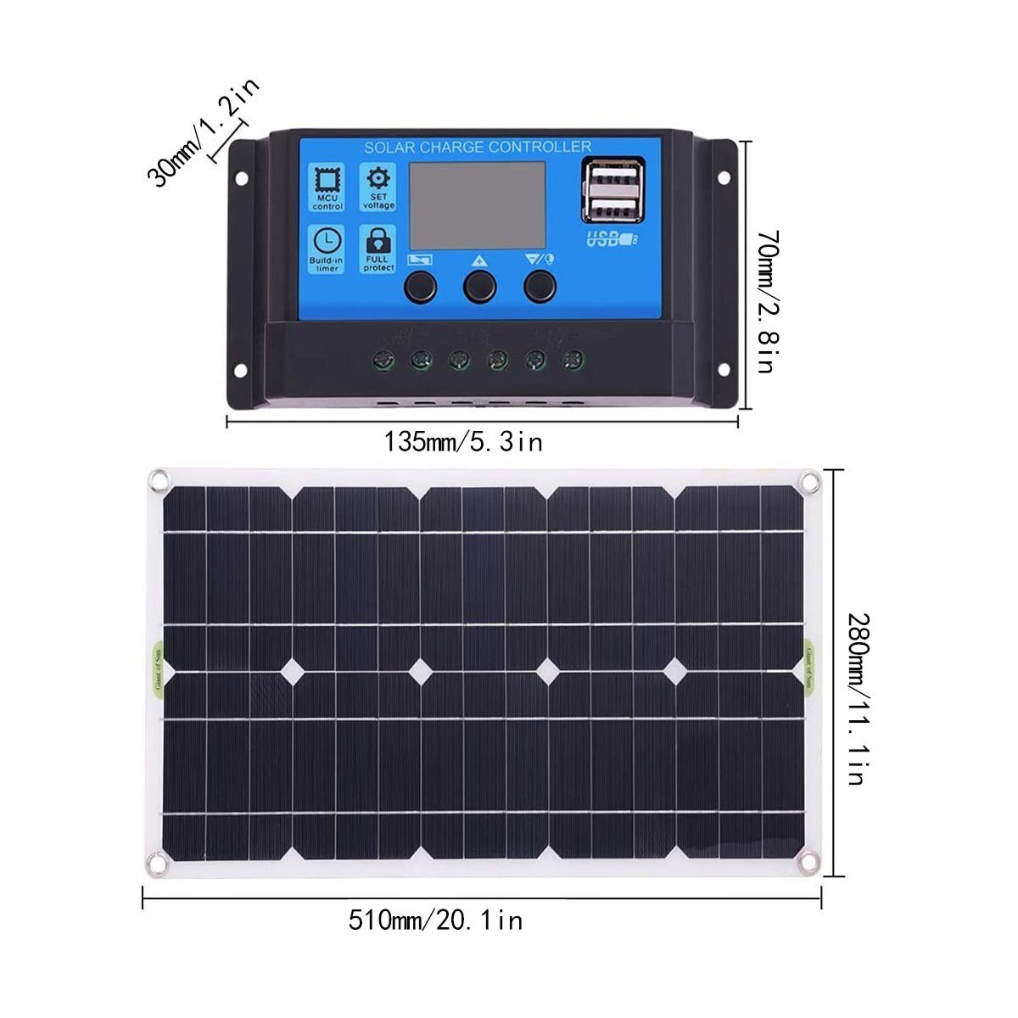
Charging System
100W (12V 8A) solar panel
Attached to vehicle 12V battery
Floating charger
12V DC barrel connector Rapid charger when not in use

Slide 42
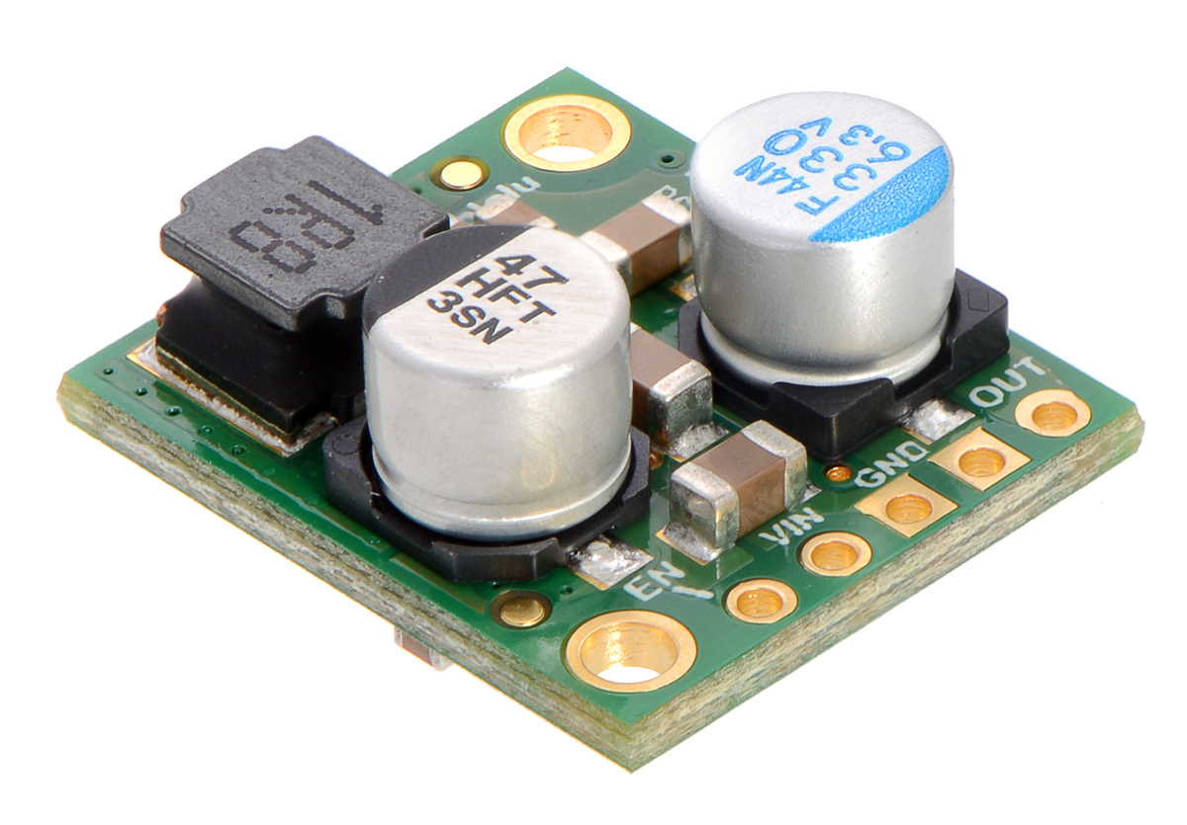
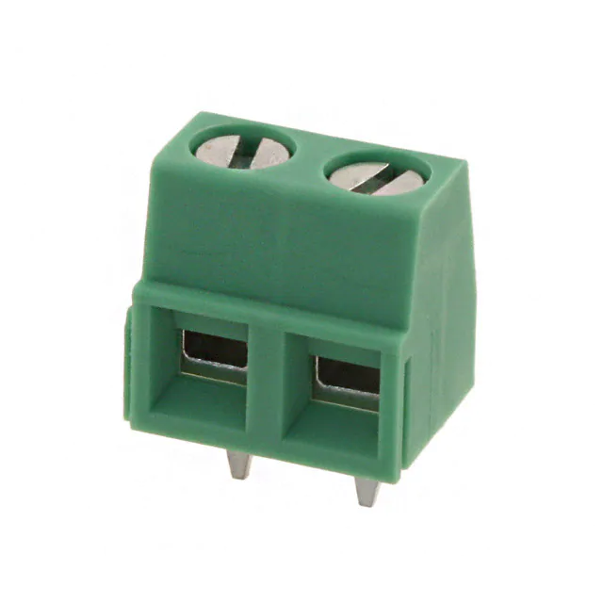
Computer Power System
A separate 12V system with a common ground
Done to isolate noise/keep connectivity when swapping vehicle power source
12V-2A power tool battery transformed down to 5V
Step down voltage regulator (d24v50f5)
Connected to battery via screw terminals (14-30 AWG)
Reverse polarity protection
Machine Vision and AI are powered by a 200W UPS
Kinect specialized power cable

Slide 43
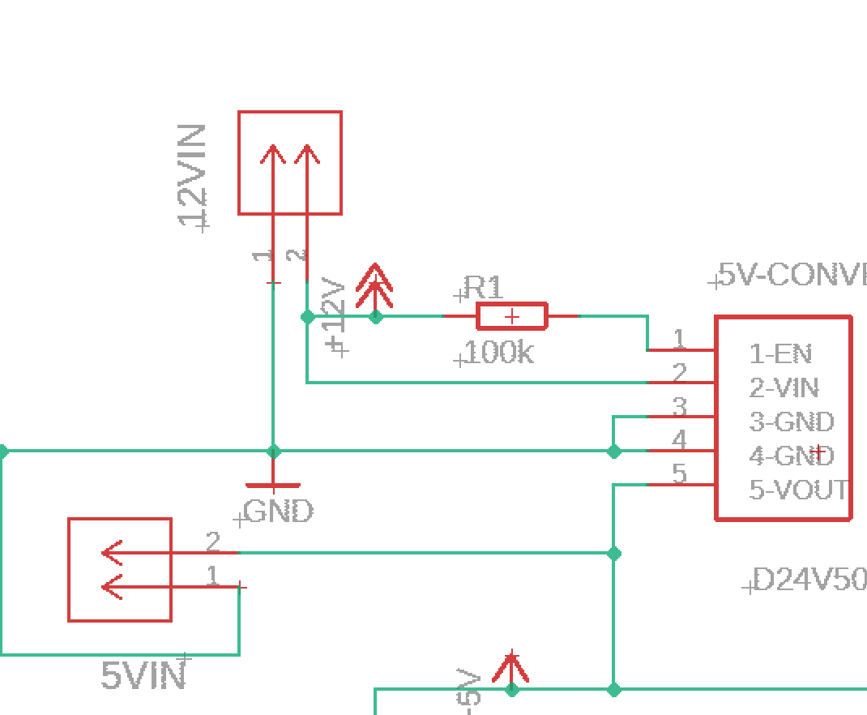
Power Input
12V/18V Input Screw Terminal
5V Voltage Regulator
with reverse polarity
protection
5V Test Point
/ Input Screw
Terminal

Slide 44
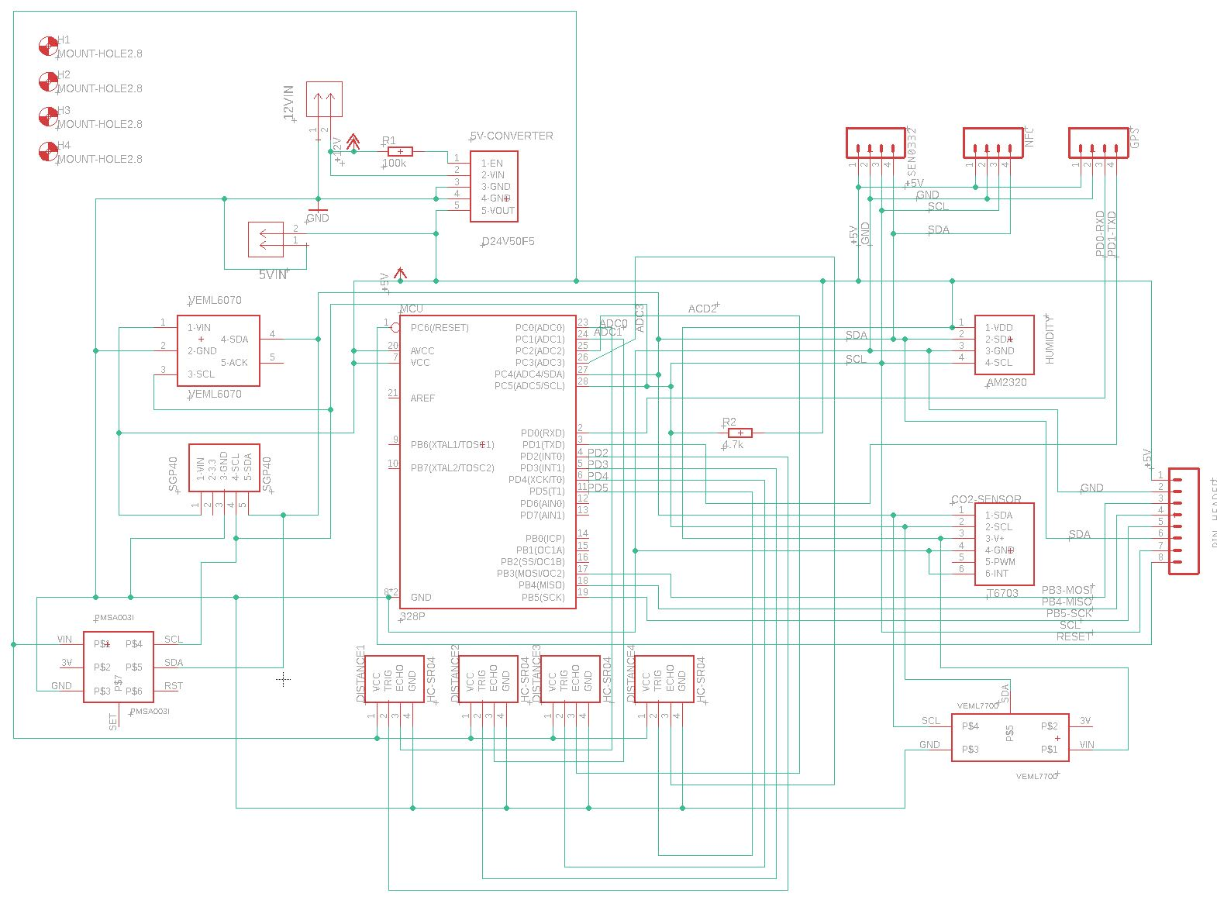
Design Schematic

Slide 45
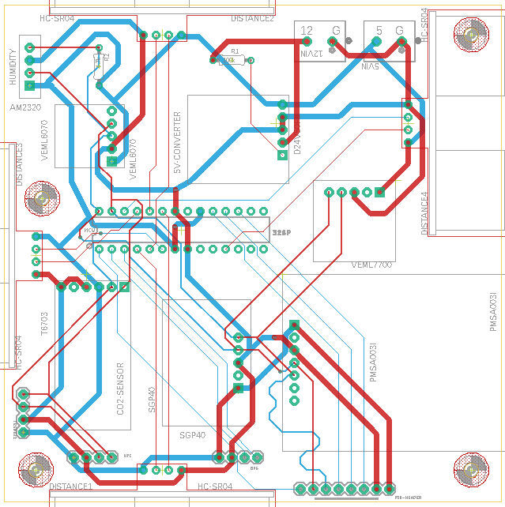
Board Design
2 layer board
2oz/ft copper
No ground plane
length/impedance matched I2C lines
2.8mm screw mounting holes for printed enclosure
Laid out for ease of testing and heat dissipation

Slide 46
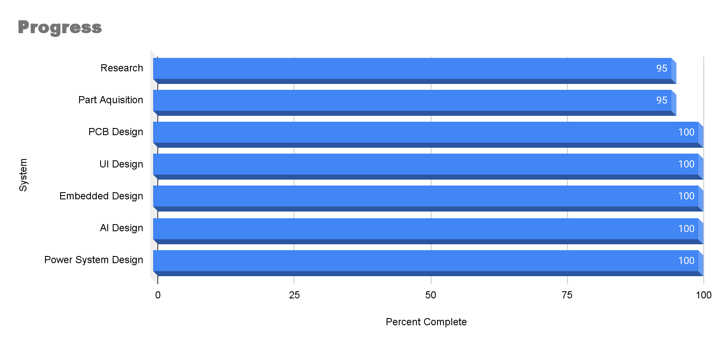
Progress

Slide 47
Troubleshooting
Our group faced multiple problems adapting and integrating all the features together in the larger vehicle.
The four main targets of our issues were:
The Autonomous Navigation & Movement
UI Design & Functionality
Sensors
3D Printing

Slide 48
Troubleshooting - Autonomous Navigation
Since ROS’s navigation stack only supports differential and holonomic steering, we had to find a way to lock the front wheels in place and drive them with the back motor. Our solution was to 3D print sprockets that attach to the wheels and attach a chain between them.
The original motors for the vehicle did not have encoders, and due to discrete jumps in GPS localization, we could not go without them. We attempted making custom encoders for the motors, however when trying to lengthen the shaft to accommodate the magnet, it was impractical to do as the motor’s kept breaking. Our solution was to buy a similar motor that didn’t have the correct gear size for the gearbox, so we 3D printed custom gears to fit over the smaller gear and extend it to fit the gearbox.
Despite our team’s best efforts and long nights, we could not provide video of the GPS navigation working on the vehicle, however there is video of it functioning on the prototype, which is shown in the demonstration in place of the vehicle.

Slide 49
Troubleshooting - UI Design & Functionality
Node Red didn’t work as well with ROS as our initial research implicated, so transferring GPS and range data to the Jetson Nano was (hard but successful/ unsuccessful)
Different connections were used:
Serial-Pins (Raspberry Pi) to Serial-Pins (Jetson Nano)
USB (Raspberry Pi) to UART (Arduino Mega)
USB (Raspberry Pi) to USB (Jetson Nano)

Slide 50
Troubleshooting - Sensors
The CO2 sensor shipped early in the project but never arrived, we tried to order the same sensor from a different website but as with the first it never arrived.
The light sensor did not work as intended whether on the breadboard or the PCB.
On occasion the ATMega will stop sending data to the Raspberry Pi and the only way to get data transfer again is to restart the ATMega

Slide 51
Troubleshooting - 3D Printing
The material used to print our custom models ruined the printer’s bed surface, causing our prints to be limited, and once our sprocket teeth sheared we were no longer able to print more. A new bed was ordered but didn’t arrive in time.
The 3D printed sprockets weren’t strong enough with the required dimensions to fit the chain. This caused many of the teeth to sheer during testing, and we couldn’t tighten the chain with a tensioner to the required specification, so it often slipped off the sprocket.

